Slide 1
Exploratory Research Design:
Qualitative Research

Slide 2

Chapter Outline
Overview
Primary Data: Qualitative Versus Quantitative Research
Rationale for Using Qualitative Research Procedures
A Classification of Qualitative Research Procedures

Slide 3
Chapter Outline
Focus Group (FG) Interviews
Depth Interviews

Slide 4

Chapter Outline
7) Projective Techniques
i. Association Techniques
ii. Expressive Techniques
a. Role Playing
iii. Applications of Projective
Techniques

Slide 5

Chapter Outline
Analysis of Qualitative Data
Ethics

Slide 6
A Classification of Marketing Research Data
Fig. 5.1
Marketing Research Data
Secondary Data
Primary Data
Qualitative Data
Quantitative Data
Descriptive
Causal
Survey Data
Observational and Other Data
Experimental Data

Slide 7
Qualitative Vs. Quantitative Research
Qualitative Research
To gain a qualitative understanding of the underlying reasons and motivations
Small number of non-representative cases
Unstructured
Non-statistical
Develop an initial understanding
Quantitative Research
To quantify the data and generalize the results from the sample to the population of interest
Large number of representative cases
Structured
Statistical
Recommend a final course of action
Objective
Sample
Data Collection
Data Analysis
Outcome

Slide 8
A Classification of Qualitative Research Procedures
Fig. 5.2
Qualitative Research Procedures
Direct (Non- disguised)
Indirect (Disguised)
Projective Techniques
Focus Groups
Depth Interviews

Slide 9

Focused Groups
A focus group is an interview conducted by a trained moderator in a non-structured and natural manner with a small group of respondents.
The moderator leads the discussion.
Source:https://www.wonderflow.co/blog/focus-group-questions

Slide 10

The main purpose of focus groups is to gain insights by listening to a group of people from the appropriate target market talk about issues of interest to the researcher.
The value of the technique lies in the unexpected findings often obtained from a free-flowing group discussion.
Source:https://blog.hubspot.com/blog/tabid/6307/bid/22025/5-focus-group-questions-to-feed-your-content-marketing.aspx

Slide 11


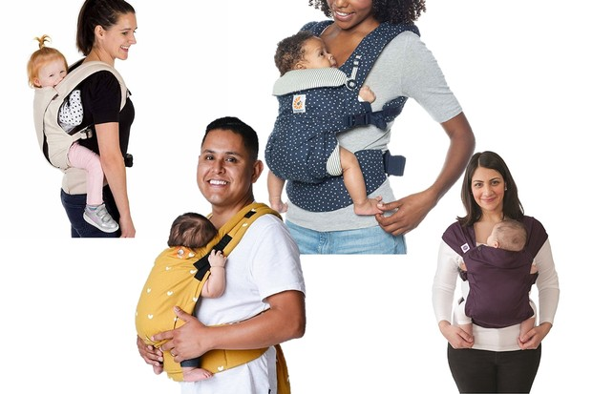
Examples

Slide 12
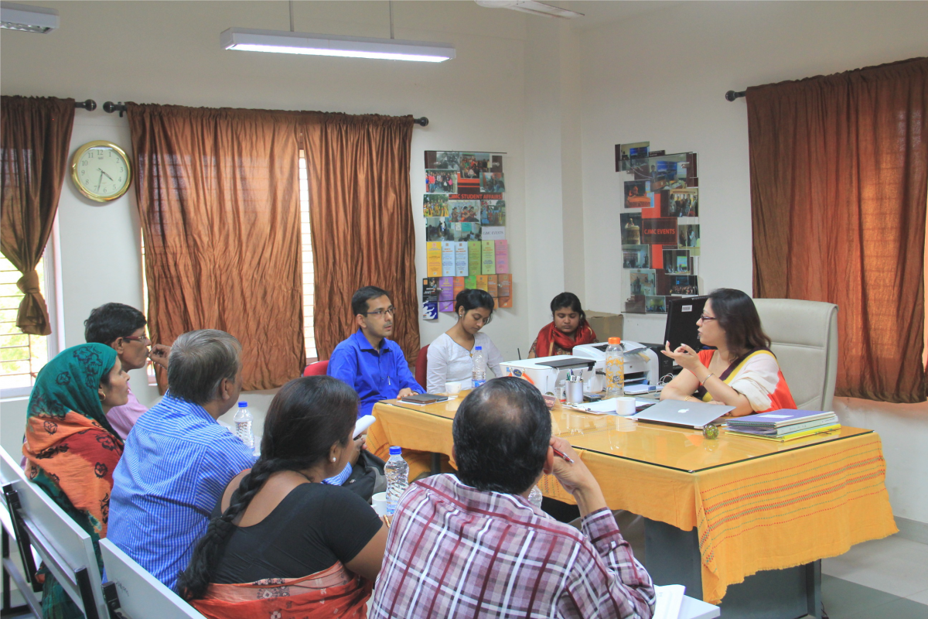

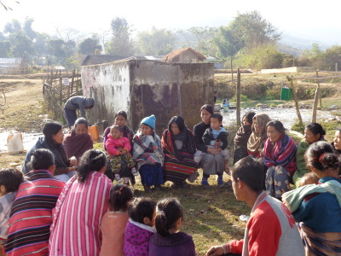
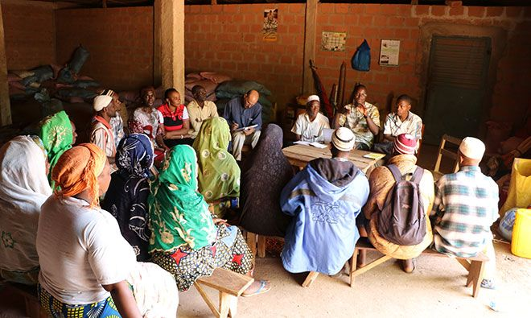
Source:https://www.iawrt.org/news/mobile-phones-empower-indian-rural-women
Source:https://humansofdata.atlan.com/2017/09/conduct-successful-focus-group-discussion/
Source: https://womensearthalliance.org/wea-voices/protecting-forest-livelihoods-biodiversity-face-climate-change/attachment/focus-group-discussion-during-impact-assessment/
Source:https://www.spring-nutrition.org/about-us/news/springguinea-and-farm-radio-international-conduct-community-radio-assessment-support

Slide 13
Focus groups are the most important qualitative research procedure.
They are so popular that many management research practitioners consider this technique synonymous with qualitative research

Slide 14
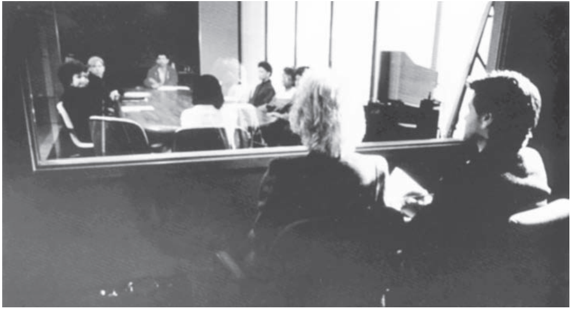

Slide 15
Characteristics of Focus Groups
Table 5.2
Group Size 8-12
Group Composition Homogeneous, respondents,
prescreened
Physical Setting Relaxed, informal atmosphere
Time Duration 1-3 hours
Recording Use of audiocassettes and videotapes
Moderator Observational, good interactive communication skills of the moderator

Slide 16
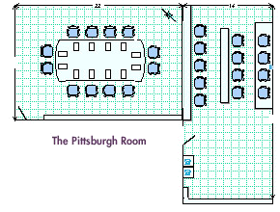
One-way mirror
Layout of focus group room and
viewing room

Slide 17

Viewing room looking into the focus group room
through one-way mirror
Source: www.campos.com/focusgs.htm

Slide 18
Key Qualifications of Focus Group Moderators
1. Kindness with firmness: The moderator must combine a disciplined detachment with understanding empathy so as to generate the necessary interaction.
2. Permissiveness: The moderator must be permissive yet alert to signs that the group’s cordiality or purpose is disintegrating.
3. Involvement: The moderator must encourage and stimulate intense personal involvement.
4. Incomplete understanding: The moderator must encourage respondents to be more specific about generalized comments by exhibiting incomplete understanding.

Slide 19
Key Qualifications of Focus Group Moderators
5. Encouragement: The moderator must encourage unresponsive members to participate.
6. Flexibility: The moderator must be able to improvise and alter the planned outline amid the distractions of the group process.
7. Sensitivity: The moderator must be sensitive enough to guide the group discussion at an intellectual as well as emotional level.

Slide 20
Procedure for Planning and Conducting Focus Groups
Fig. 5.3
Determine the Objectives and Define the Problem
Specify the Objectives of Qualitative Research
State the Objectives/Questions to be Answered by Focus Groups
Write a Screening Questionnaire
Develop a Moderator’s Outline
Conduct the Focus Group Interviews
Review Tapes and Analyze the Data
Summarize the Findings and Plan Follow-Up Research or Action

Slide 21
In the department store study, the objectives of qualitative research were as follows:
Identify the relevant factors (choice criteria) used by households in selecting department stores.
Identify what consumers consider to be competing stores for specific product categories.

Slide 22
Variations in Focus Groups
Two-way focus group. This allows one target group to listen to and learn from a related group. For example, a focus group of physicians viewed a focus group of arthritis patients discussing the treatment they desired.
Dual-moderator group. A focus group conducted by two moderators: One moderator is responsible for the smooth flow of the session, and the other ensures that specific issues are discussed.
Dueling-moderator group. There are two moderators, but they deliberately take opposite positions on the issues to be discussed.

Slide 23
Variations in Focus Groups
Respondent-moderator group. The moderator asks selected participants to play the role of moderator temporarily to improve group dynamics.
Client-participant groups. Client personnel are identified and made part of the discussion group.
Mini groups. These groups consist of a moderator and only 4 or 5 respondents.
Telesession groups. Focus group sessions by phone using the conference call technique.
Online focus groups. Focus groups conducted online over the Internet.

Slide 24
Advantages of Focus Groups
Snowballing
Stimulation
Security
Spontaneity
Scientific scrutiny
Structure
Speed

Slide 25
Disadvantages of Focus Groups
Misuse
Misjudge
Moderation
Messy
Misrepresentation

Slide 26
Applications of Focus Groups
1. Understanding consumers’ perceptions, preferences, and behavior concerning a product category
2. Obtaining impressions of new product concepts
3. Generating new ideas about older products
4. Developing creative concepts and copy material for advertisements
5. Securing price impressions
6. Obtaining preliminary consumer reaction to specific marketing program

Slide 27
Online Versus Traditional Focus Groups
Table 5.3
Characteristic Online Focus Groups Traditional Focus Groups
Group size 4-6 8-12
Group composition Anywhere in the world Drawn from the local area
Time duration 1-1.5 hours 1-3 hours
Physical setting Researcher has little control Under the control of the researcher
Respondent identity Difficult to verify Can be easily verified
Respondent attentiveness Respondents can engage in other tasks Attentiveness can be monitored

Slide 28
Online Versus Traditional Focus Groups
Table 5.3, cont.
Respondent recruiting Easier. Can be recruited online, e-mail, Recruited by traditional means
panel, or by traditional means (telephone, mail, mail panel)
Group dynamics Limited snowballing
Openness of respondents Respondents are more candid Respondents are candid, except for due to lack of face-to-face contact sensitive topics
Nonverbal communication Body language cannot be observed. Body language and emotions Emotions expressed by using symbols observed
Use of physical stimuli Limited to those that can be displayed A variety of stimuli (products, on the Internet advertising demonstrations, etc.) can be used

Slide 29
Online Versus Traditional Focus Groups
Table 5.3, cont.
Transcripts Available immediately Time consuming and expensive to obtain
Observers’ communication Observers can communicate with the Observers can manually send notes
with moderator the moderator on a split-screen to the focus group room
Unique moderator skills Typing, computer usage, familiarity Observational
with chat room slang
Turnaround time Can be set up and completed Takes many days for setup and in a few days completion
Client travel costs None Can be expensive
Client Involvement Limited High
Basic focus group costs Much less expensive More expensive: facility rental, food, taping, transcript preparation

Slide 30
Advantages of Online Focus Groups
Geographical constraints are removed and time constraints are lessened.
Unique opportunity to re-contact group participants at a later date.
Can recruit people not interested in traditional focus groups: doctors, lawyers, etc.
There is no travel, videotaping, or facilities to arrange so the cost is much lower.

Slide 31
Disadvantages of Online Focus Groups
Only people that have access to the Internet can participate.
There is lack of general control over the respondent's environment.
Only audio and visual stimuli can be tested. Products can not be touched (e.g., clothing) or smelled (e.g., perfumes).

Slide 32
The methodological applications of focus groups include:
1. Defining a problem more precisely
2. Generating alternative courses of action
3. Developing an approach to a problem
4. Obtaining information helpful in structuring consumer questionnaires
5. Generating hypotheses that can be tested quantitatively
6. Interpreting previously obtained quantitative results

Slide 33
Depth interview
An unstructured, direct, personal interview in which a single respondent is probed by a highly skilled interviewer to uncover underlying motivations, beliefs, attitudes, and feelings on a topic.

Slide 34
Depth interviews are another method of obtaining qualitative data.

Slide 35
Like focus groups, depth interviews are an unstructured and direct way of obtaining information, but unlike focus groups, depth interviews are conducted on a one-on-one basis.
A depth interview is an unstructured, direct, personal interview in which
a single respondent is probed by a highly skilled interviewer to uncover underlying motivations, beliefs, attitudes, and feelings on a topic

Slide 36
A depth interview may take from 30 minutes to more than one hour.
To illustrate the technique in the context of the department store example, the interviewer begins by asking a general question such as,
“How do you feel about shopping at department stores?”
The interviewer then encourages the subject to talk freely about his or her attitudes toward department stores.
After asking the initial question, the interviewer uses an unstructured format.

Slide 37
Focus Groups Versus Depth Interviews
Table 5.4
Characteristic
Focus
Groups
Depth
Interviews
Group dynamics + -
Peer pressure/group influence - +
Client involvement + -
Generation of innovative ideas + -
In-depth probing of individuals - +
Uncovering hidden motives - +
Discussion of sensitive topics - +

Slide 38
Focus Groups Versus Depth Interviews
Table 5.4, cont.
Characteristic
Focus
Groups
Depth
Interviews
Interviewing competitors
Interviewing professional respondents
Scheduling of respondents
Amount of information
Bias in moderation and interpretation
Cost per respondent
Time (interviewing & analysis)
-
-
-
+
+
+
+
+
+
+
-
-
-
-
Note: A + indicates a relative advantage over the
other procedure, a - indicates a relative disadvantage.

Slide 39
Definition of Projective Techniques
An unstructured, indirect form of questioning that encourages respondents to project their underlying motivations, beliefs, attitudes or feelings regarding the issues of concern.

Slide 40
In projective techniques, respondents are asked to interpret the behavior of others.

Slide 41
Expressive Techniques
In expressive techniques, respondents are presented with a verbal or visual situation and asked to relate the feelings and attitudes of other people to the situation.
Role playing. Respondents are asked to play the role or assume the behavior of someone else.

Slide 42
Analysis of Qualitative Data
Data reduction – Select which aspects of the data are to be emphasized, minimized, or set aside for the project at hand.
Data display – Develop a visual interpretation of the data with the use of such tools as a diagram, chart, or matrix. The display helps to illuminate patterns and interrelationships in the data.
Conclusion drawing and verification – Consider the meaning of analyzed data and assess its implications for the research question at hand.

Slide 43
Ethical Issues
Ethical issues related to the respondents and the general public are of primary concern.
Disguise can violate the respondents' right to know and result in psychological harm.
In debriefing sessions, respondents should be informed about the true purpose and given opportunities to ask questions.
The use of qualitative research results for questionable purposes raises ethical concerns

Slide 44
Ethical Issues
Deceptive procedures that violate respondents’ right to privacy and informed consent should be avoided.
Video- or audio-taping the respondents without their prior knowledge or consent raises ethical concerns.
The comfort level of the respondents should be addressed.

Slide 45

All rights reserved. No part of this publication may be reproduced, stored in a retrieval system, or transmitted, in any form or by any means, electronic, mechanical, photocopying, recording, or otherwise, without the prior written permission of the publisher. Printed in the United States of America.
Copyright © 2010 Pearson Education, Inc.

